Slide 1

Oracle HCM ERP
Payroll team

Slide 2
Oscar organization
Welcome to the Oscar Organization Payroll Project. As a leading provider of financial services, Oscar Organization is committed to delivering exceptional results and exceeding expectations. With a strong focus on integrity, transparency, and customer satisfaction, our organization relies on a dedicated team of professionals who work tirelessly behind the scenes to provide innovative financial solutions to individuals, businesses, and institutions.
As we continue to grow and evolve, our payroll processes play a critical role in ensuring that our employees are compensated accurately and on time. This project aims to implement a robust and efficient payroll system that streamlines our processes, reduces errors, and enhances the overall employee experience

Slide 3
Oscar organization
Throughout this project, we will work closely with stakeholders across the organization to design, develop, and deploy a payroll solution that meets our unique needs and requirements. Our goal is to create a payroll system that is scalable, secure, and compliant with all relevant regulations

Slide 4
Content
1- Setup for Oscar organization
2- Creating Work structure
3- Creating payroll

Slide 5
1- Setup
1- creating user
2- creating responsibility
3- linking responsibility with user
4- creating value sets (Job, Position, Grade, Competence, People group, Cost allocation)
5- Create values

Slide 6
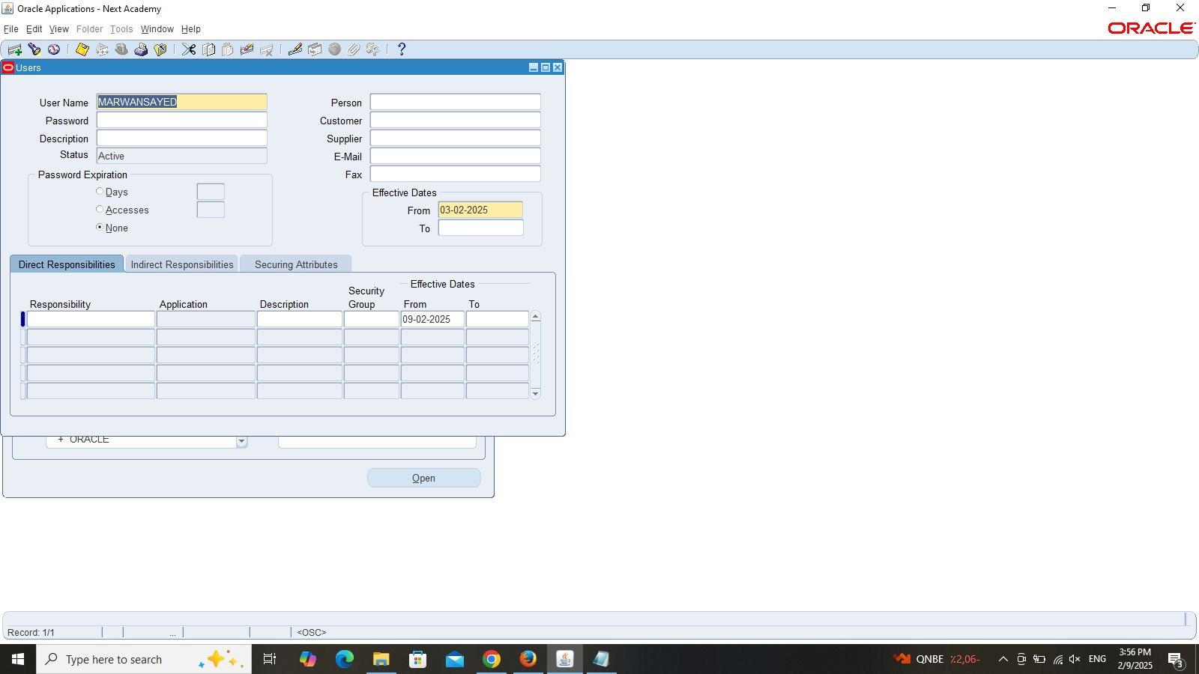
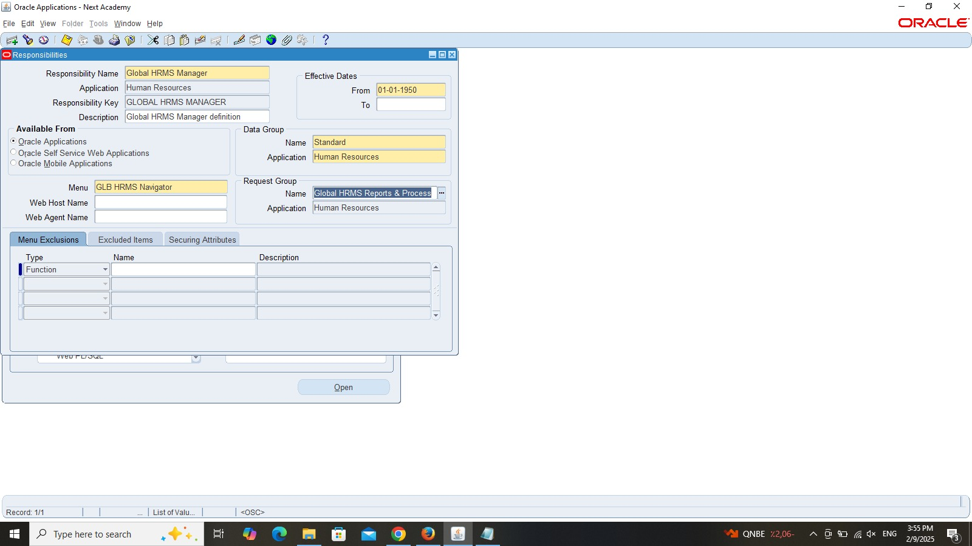
1- setup
Path>Security>user>define
(System administrator responsibility)
Path>security>responsibility>define
(System administrator responsibility)

Slide 7
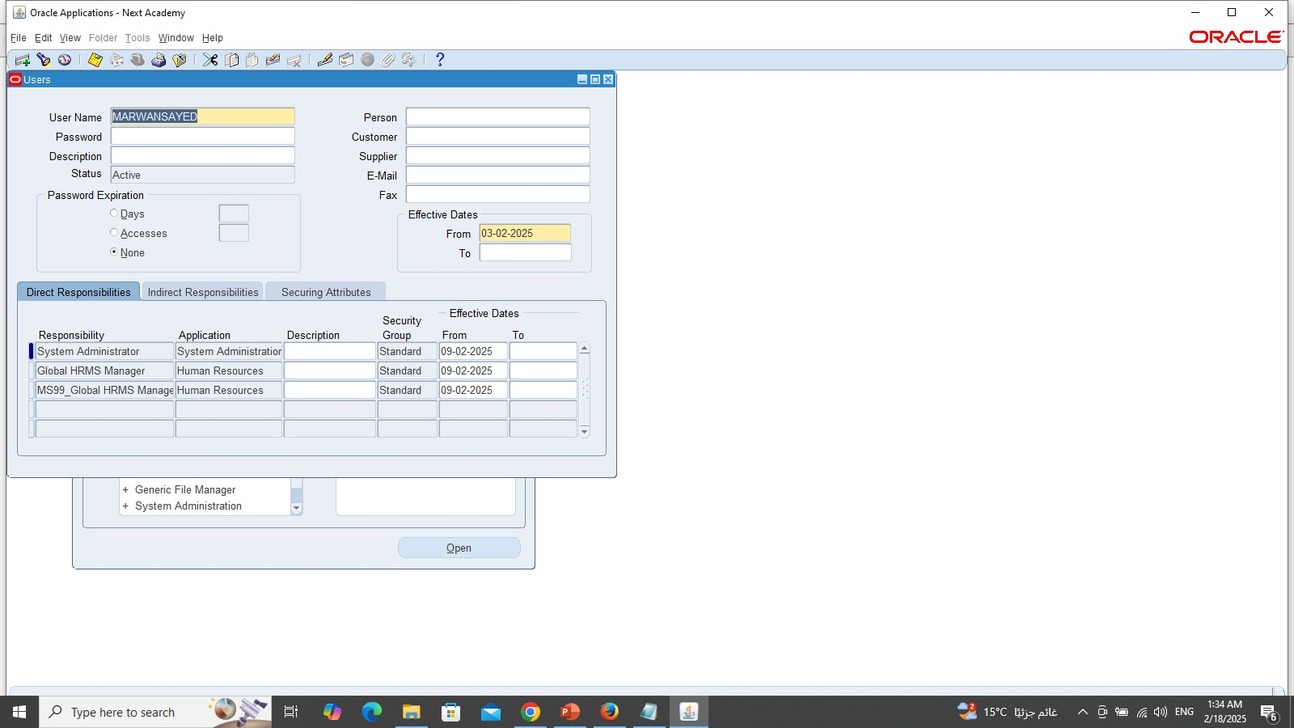
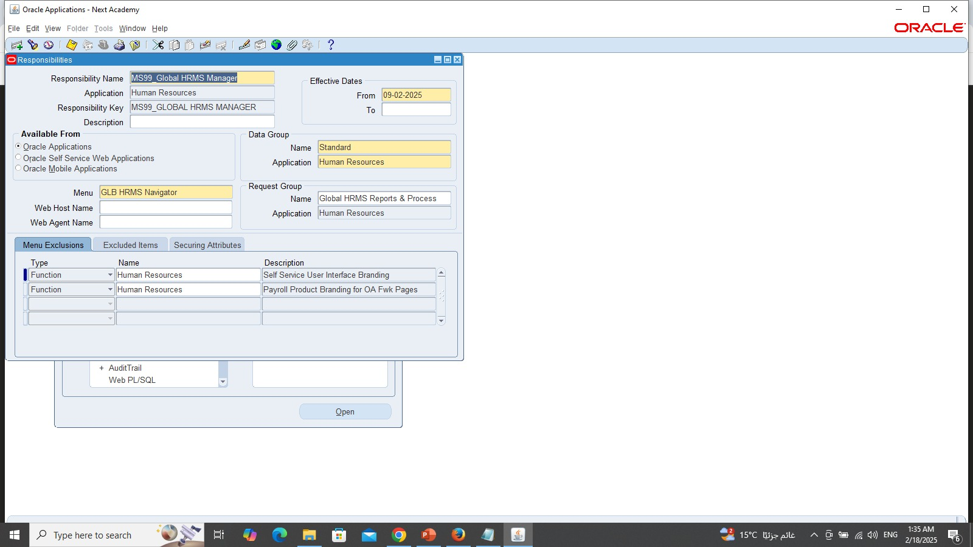
1- setup
Creating responsibility (MS99_Global HRMS Manager) and linking it with the user (Marwan Sayed)
We can insert Global HRMS manager just incase if there is any error shows up

Slide 8
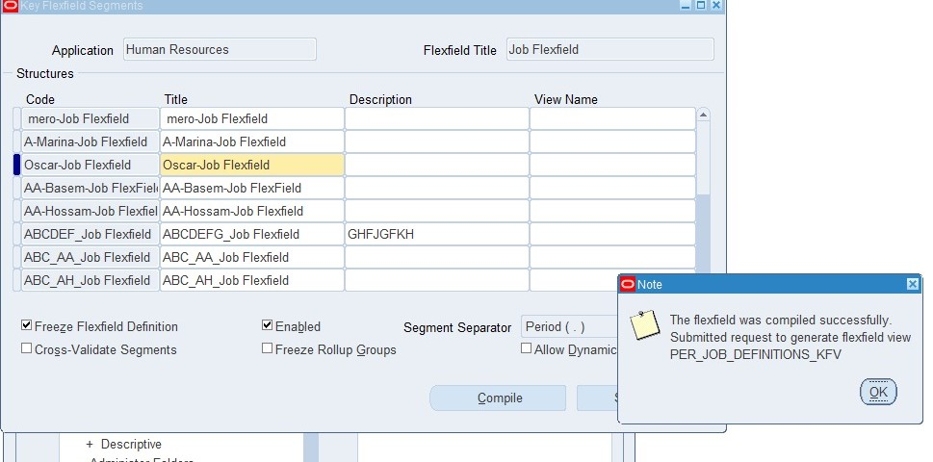
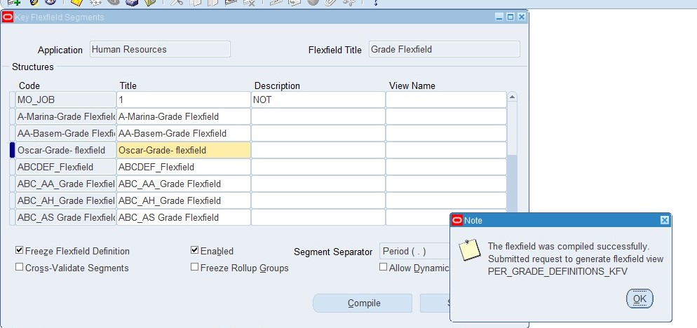
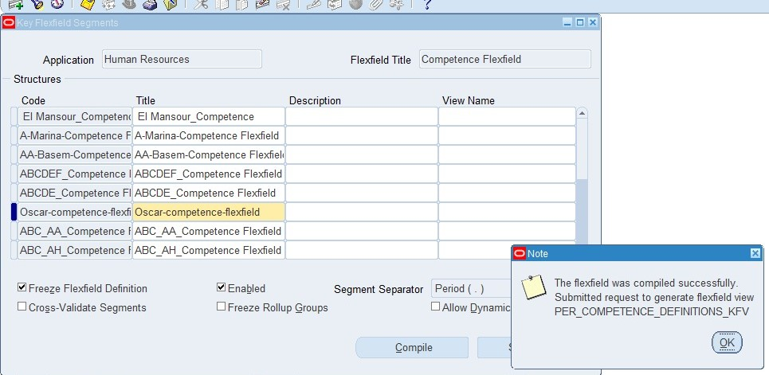
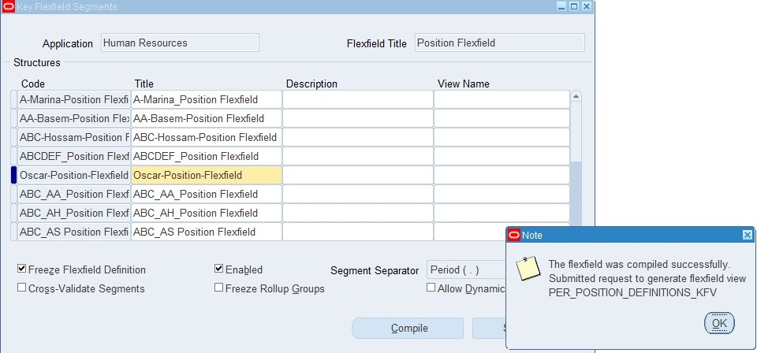
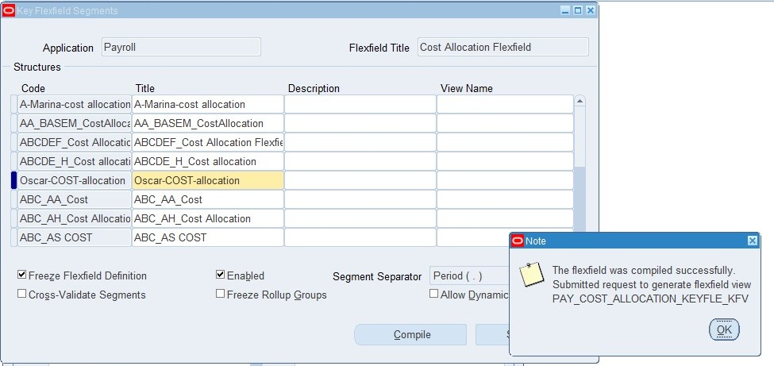
1-setup
Creating Value sets and its values
Path>Application>flex field>key>segments
Notice: after creation of the flex field, you need to compile and click on enable insert and freeze to avoid troubleshooting

Slide 9
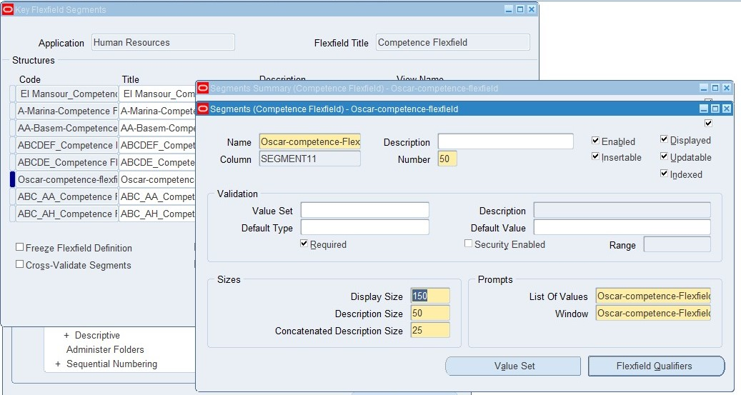
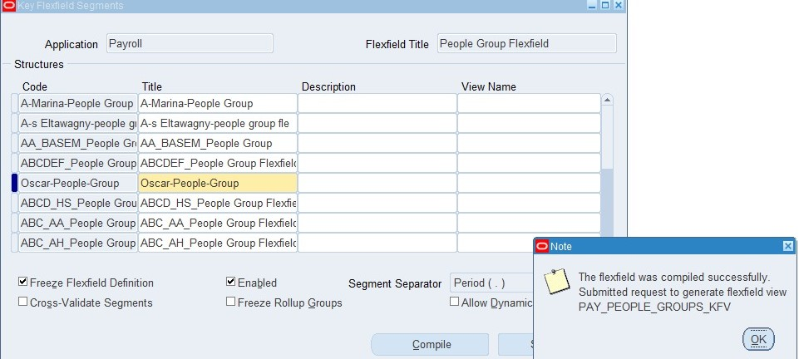
1- Setup
Creating Value sets and its values
Path>Application>flex field>key>segments
Notice: after creation of the flex field, you need to compile and click on enable insert and freeze to avoid troubleshooting in order to allow coding while inserting information in work structure phase

Slide 10
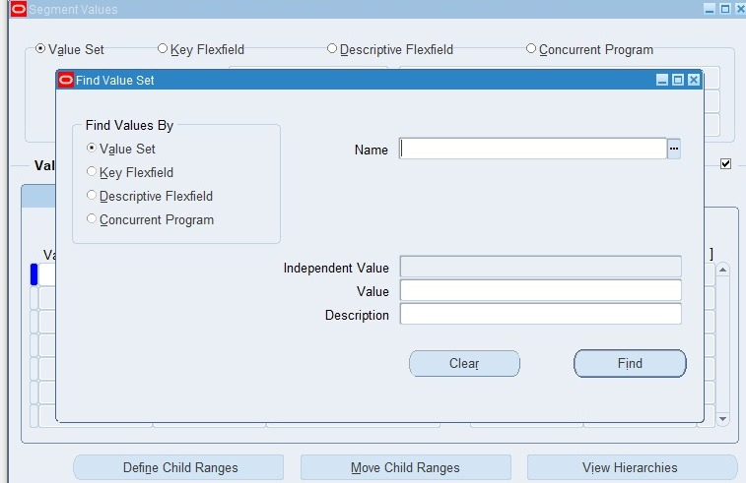
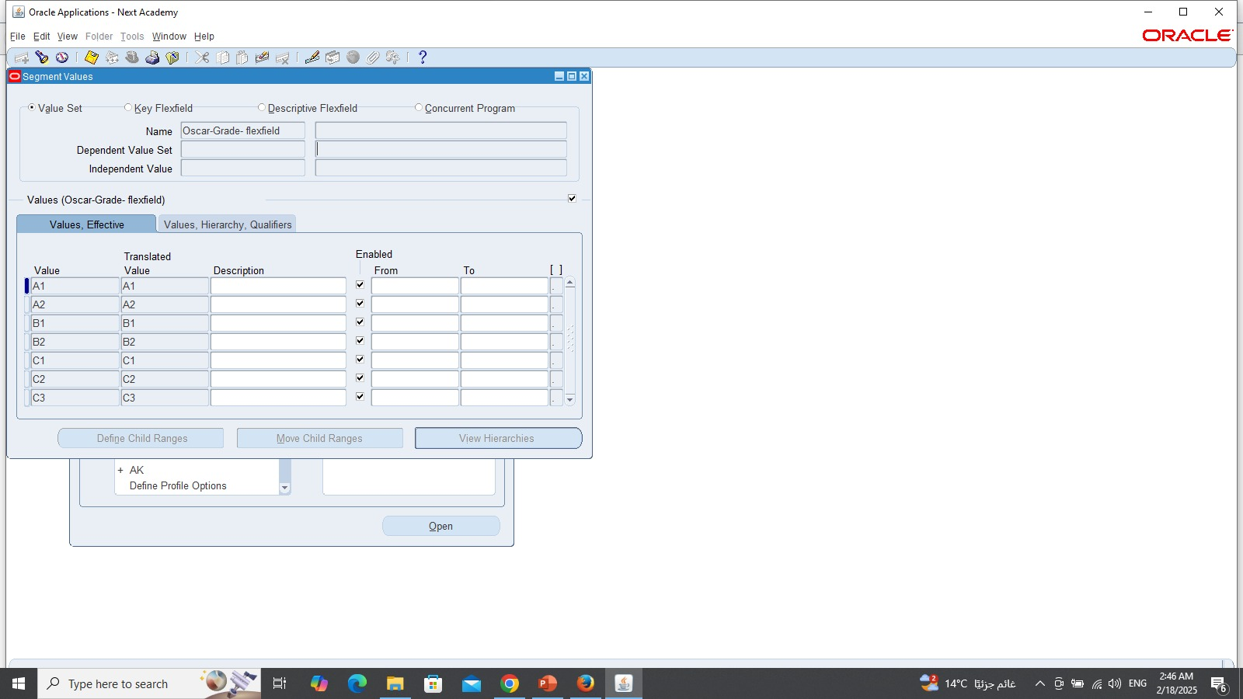
1- Setup
Path>Application>validation>Values
(System administrator responsibility)

Slide 11
2- Work structure
1- Create Organization (Oscar organization) and linking it with responsibility
2- Create Position
3- Create Job
4- Create grade
5- Create User

Slide 12
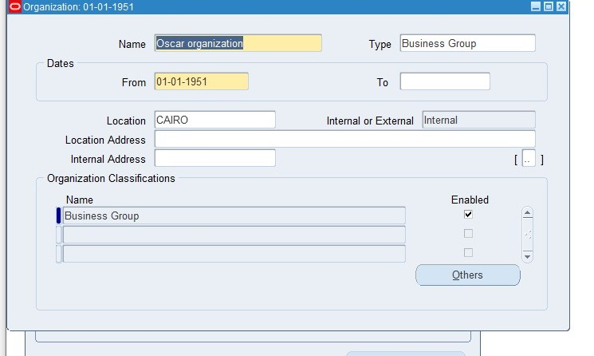
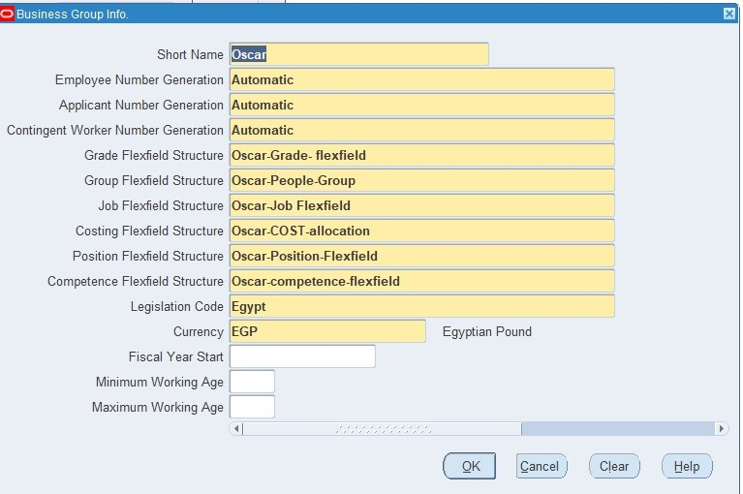
2- Work structure
Path> Work structure>organization> Description
(MS99_Responsibility)

Slide 13
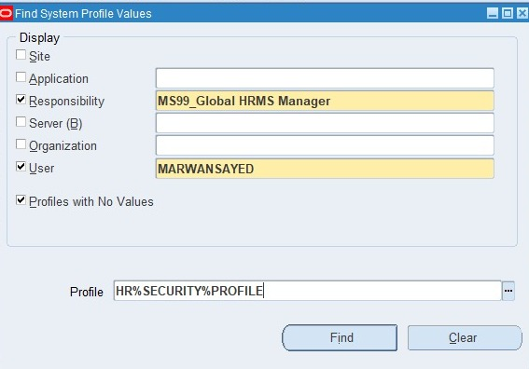
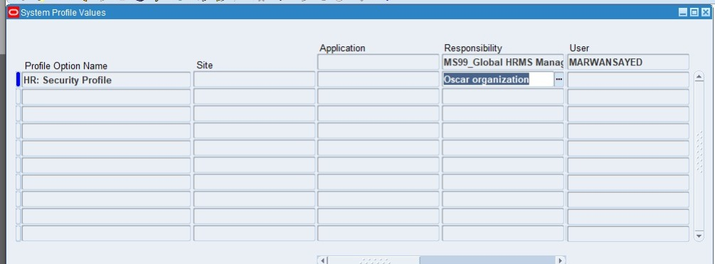
2-Work structure
Path>Profile>System
(Responsibility (system administrator)

Slide 14
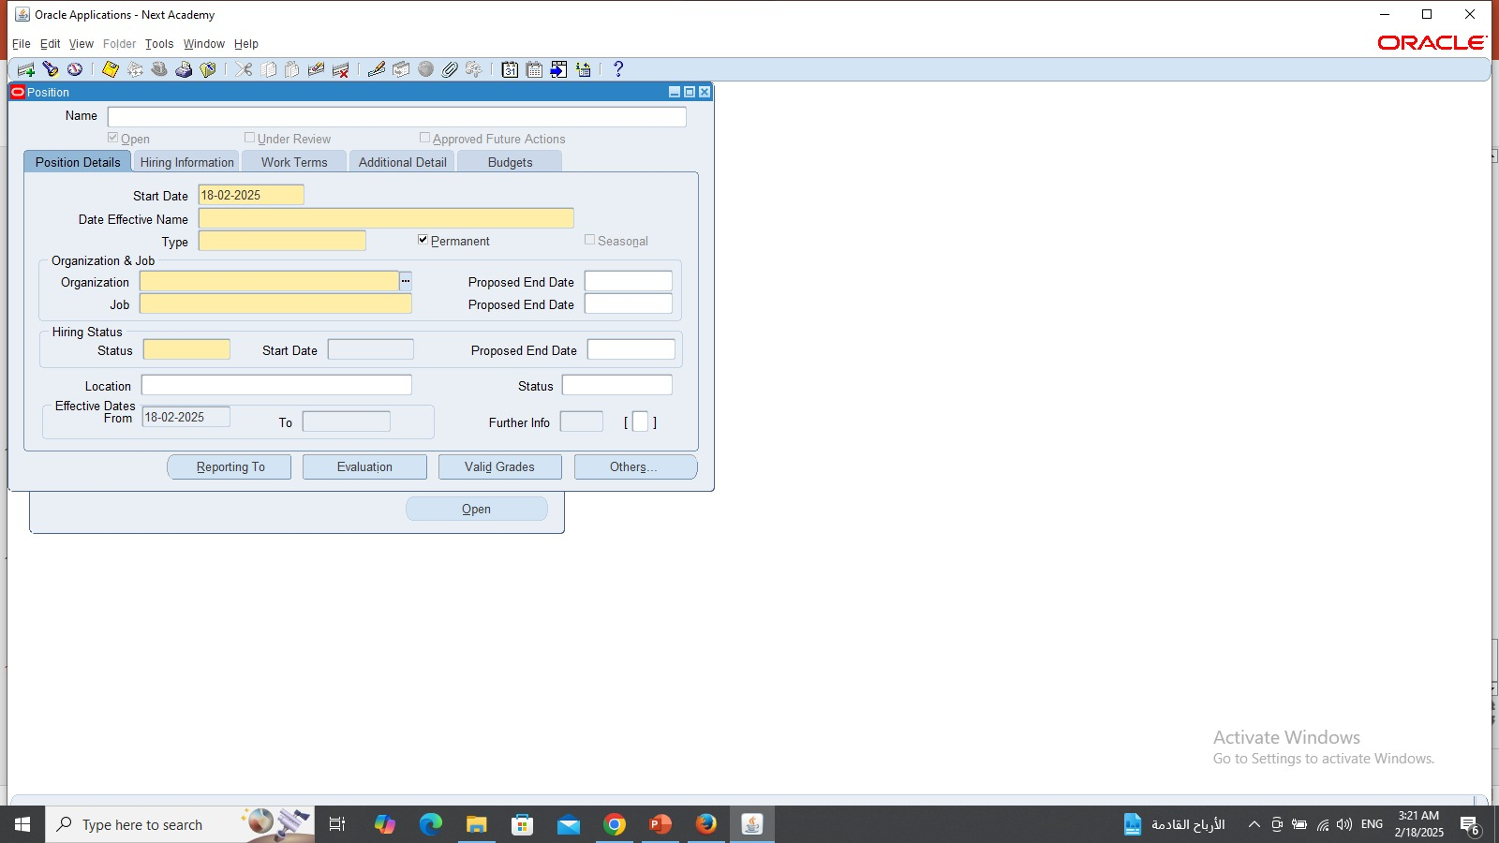
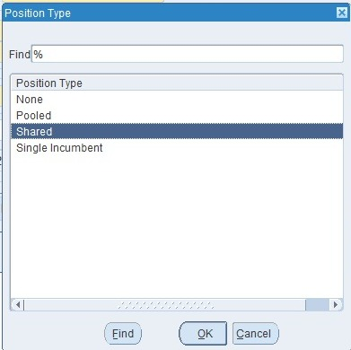
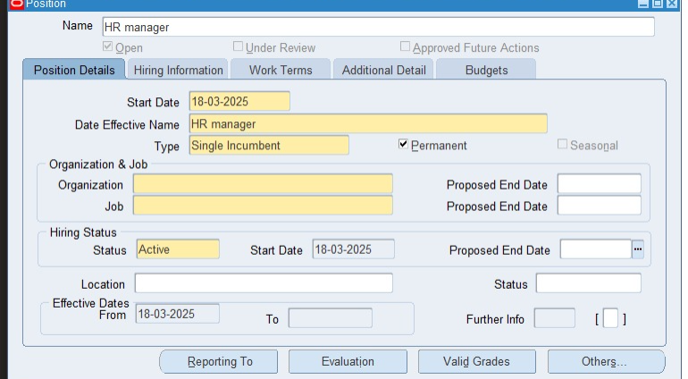
2-Work structure
Path>Work structure>Position>Description
(MS99_Responsibility)

Slide 15
Positions
1. Chief Financial Officer (CFO): The CFO is responsible for overseeing the financial strategy and direction of the organization. This includes managing financial planning, budgeting, forecasting, and reporting
2. Financial Analyst: The Financial Analyst is responsible for analyzing financial data to inform business decisions. This includes preparing financial reports, analyzing trends, and identifying areas for cost savings.
3. Risk Management Officer: The Risk Management Officer is responsible for identifying and mitigating financial risks within the organization. This includes developing and implementing risk management strategies and policies

Slide 16
Positions
4. Compliance Officer: The Compliance Officer is responsible for ensuring that the organization is in compliance with all relevant financial regulations and laws. This includes monitoring and reporting on compliance activities
5. Payroll Manager: The Payroll Manager is responsible for managing the payroll function within the organization. This includes ensuring that employees are paid accurately and on time
6. Financial Advisor: The Financial Advisor is responsible for providing financial guidance and support to clients. This includes developing and implementing financial plans and strategies
7. Customer Service Representative: The Customer Service Representative is responsible for providing exceptional customer service to clients. This includes responding to inquiries, resolving issues, and providing product information

Slide 17
Positions
8. IT Support Specialist: The IT Support Specialist is responsible for providing technical support and maintenance services to ensure the smooth operation of computer systems and network infrastructure
9. HR Manager: The HR Manager is responsible for overseeing the human resources function within the organization. This includes managing recruitment, talent development, benefits administration, and employee relations
10. Recruiter- Reports to: The Recruiter is responsible for sourcing and attracting top talent to fill open positions within the organization
11. HR Generalist: The HR Generalist is responsible for providing generalist HR support to the organization. This includes managing employee data, administering benefits, and providing guidance on HR

Slide 18
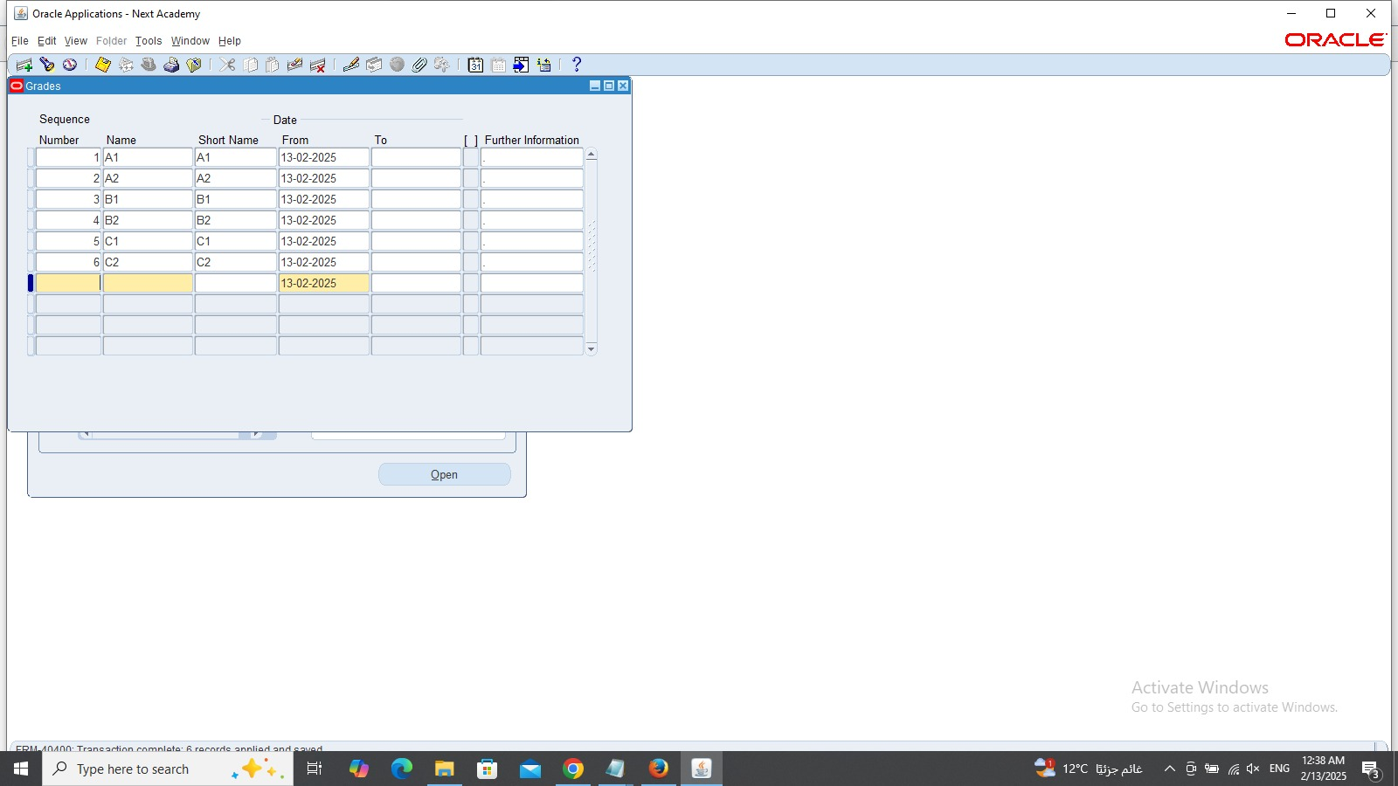
2-Work structure
Path>Work structure> Grade>description
(MS99_Responsibility)

Slide 19
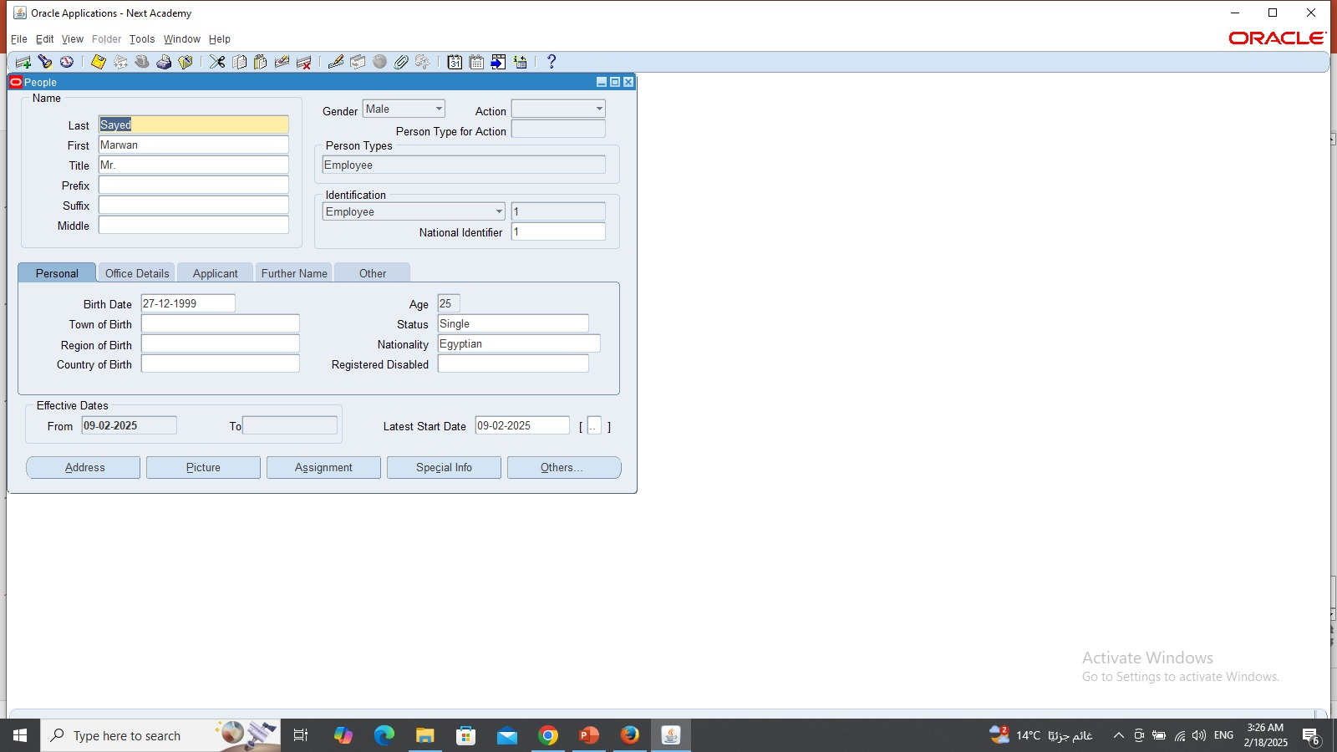
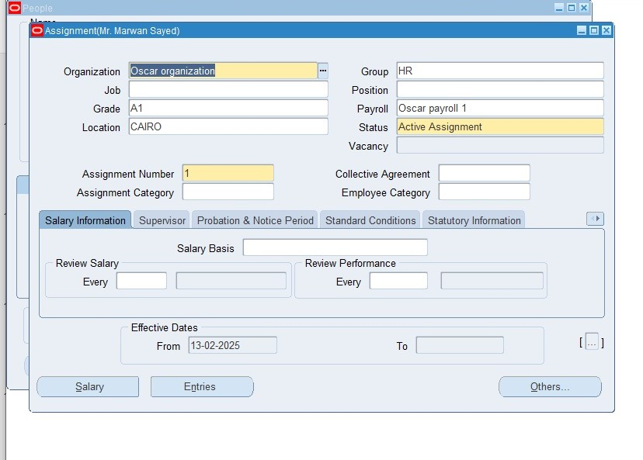
2- Work structure
Path>people> enter and maintain
(MS99_Responsibility)
Then click on assignment to apply all setups

Slide 20
3- Payroll
1- Create consolidation
2- Create payroll (payment methods and payment types)
3- Create Elements
4- Link payroll with people
5- link elements with people
6- Salary basis
7- Quick pay

Slide 21
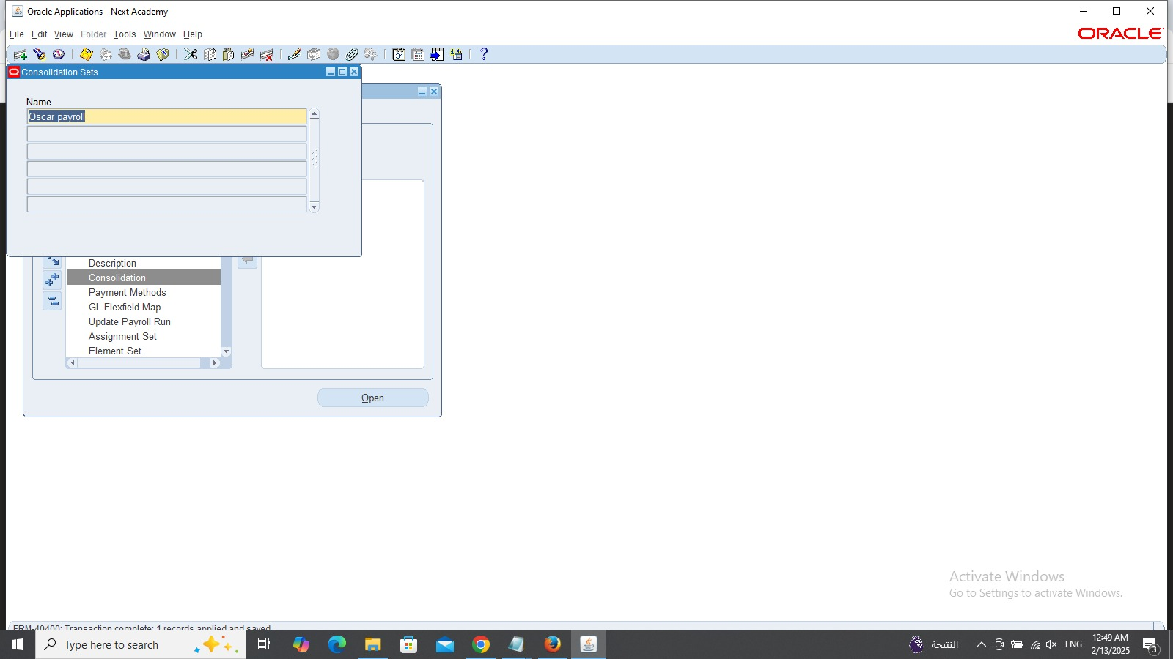
3- Payroll
Path>payroll>consolidation
(Responsibility MS99_)

Slide 22
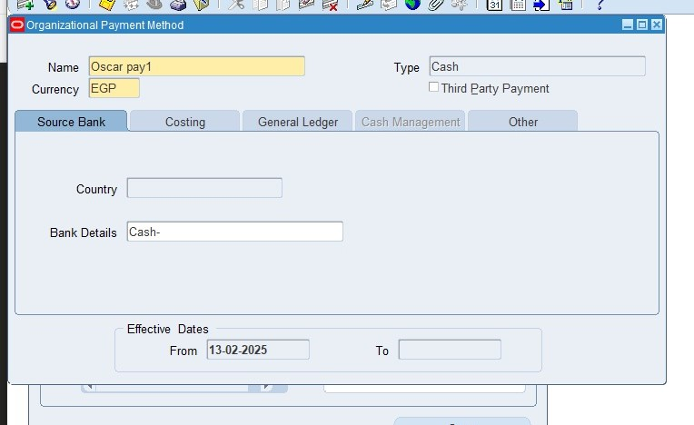
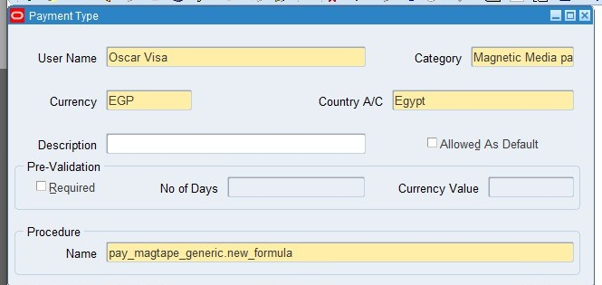
3- Payroll
Path>payroll>payment method
(Responsibility MS99_)
Path>Payroll>payment types
(Responsibility MS99_)

Slide 23
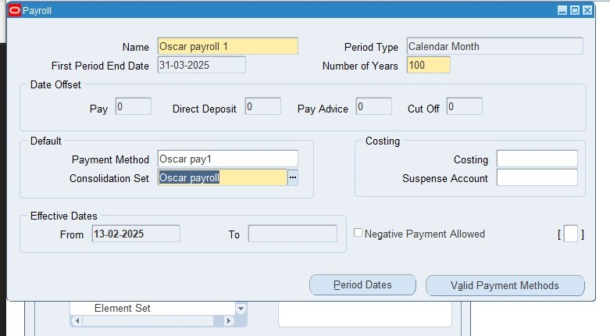
3- Payroll
Path>Payroll>description
(Responsibility MS99_)

Slide 24
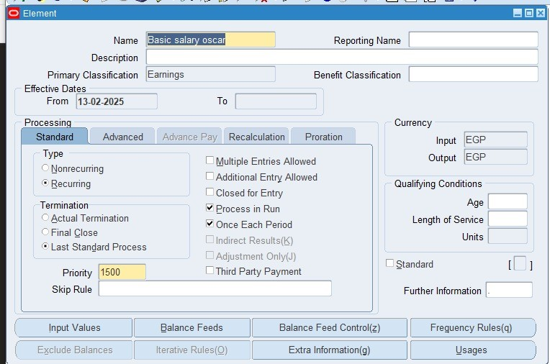
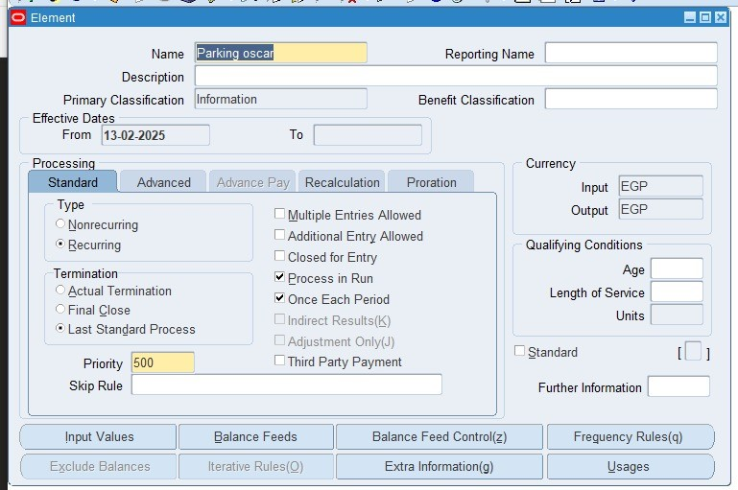
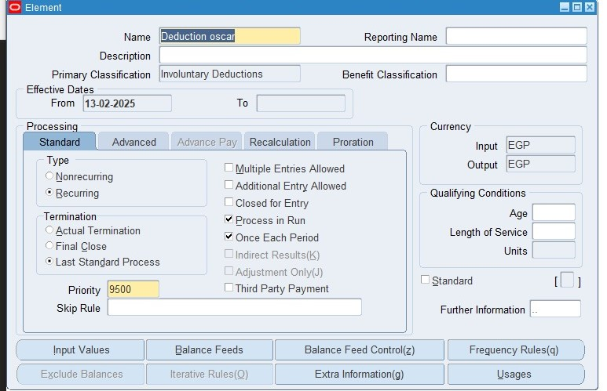
3- Payroll
Path>Total consumption>basic>element description
We made three types of elements
(Earnings, deduction and information)
(Responsibility MS99_)

Slide 25
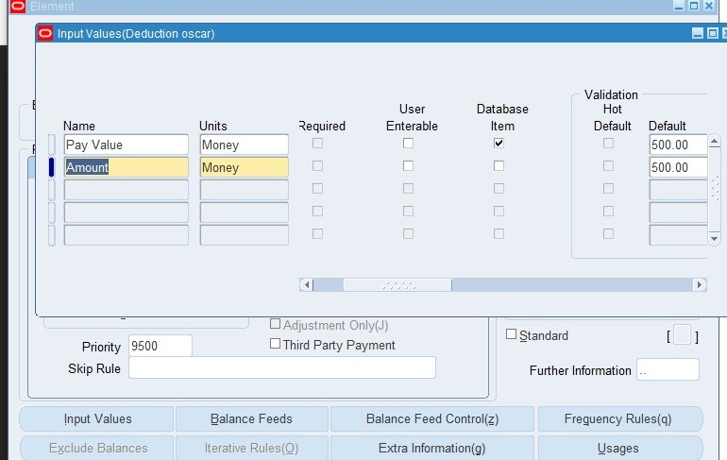
3-Payroll
After that don’t forget to press on input value at the same window which you can make the user to insert the amount through his window and if you want to disable it make sure to clear the marker from (user enterable) and you can insert the amount that the owner wants in the default

Slide 26
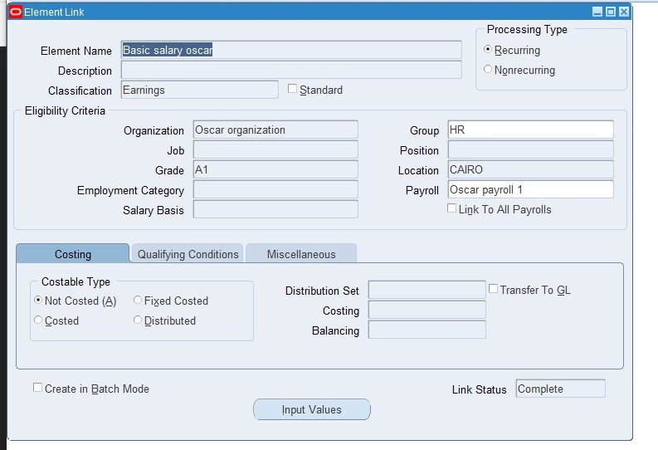
3- Payroll
Path>total consumption>basic>link
(Responsibility MS99_)

Slide 27
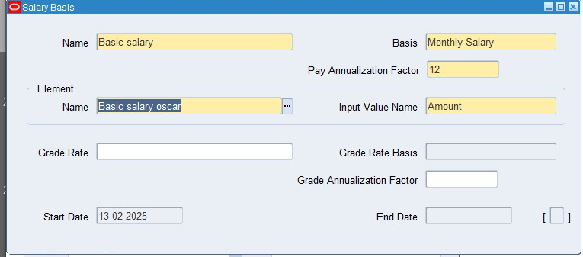
3- Payroll
Path>Total consumption >> Basic>>Salary basis

Slide 28
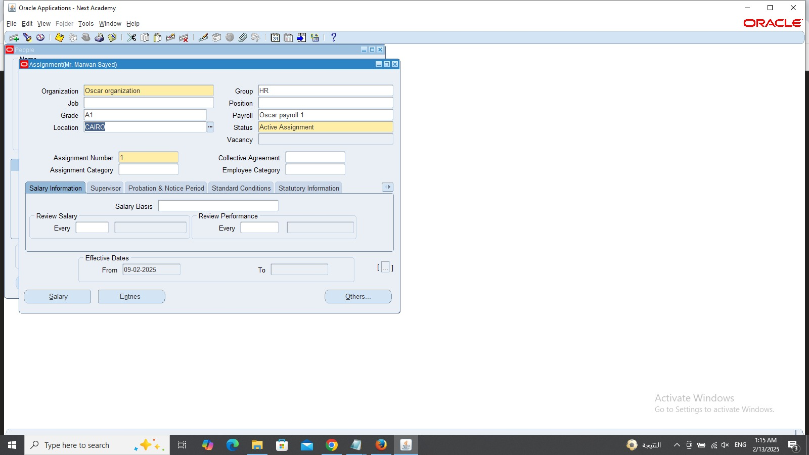
3- Payroll
Path>people>enter and maintain>assignment
(Responsibility MS99_)

Slide 29
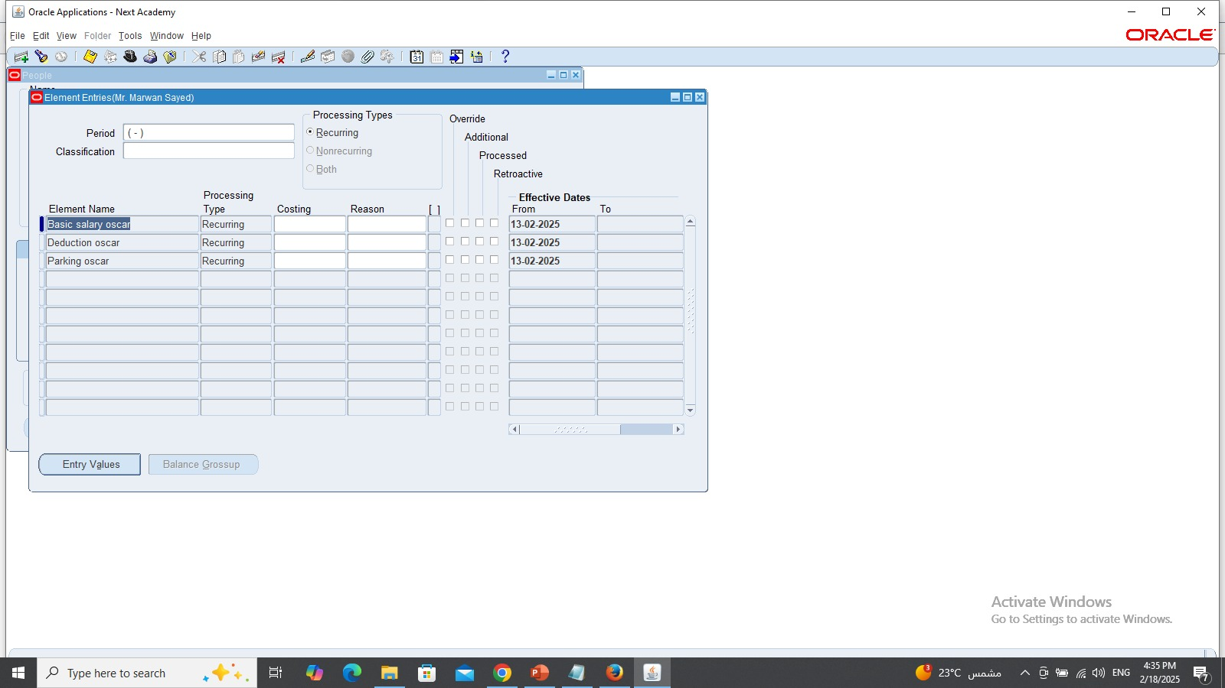
3-Payroll
Path>people>enter and maintain>assignment>entries
(Responsibility MS99_)

Slide 30
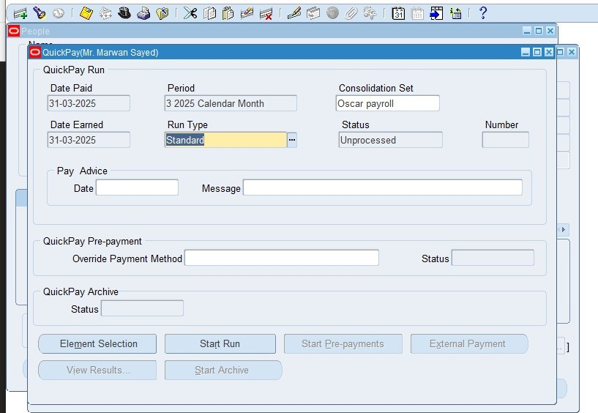
3- Payroll
Path>people>enter and maintain>assignment>others> Quick pay then we press at start run and after that we will click on
View>request at the top we will see that the request already done as a tutorial for payroll system
(Responsibility MS99_)

Slide 31
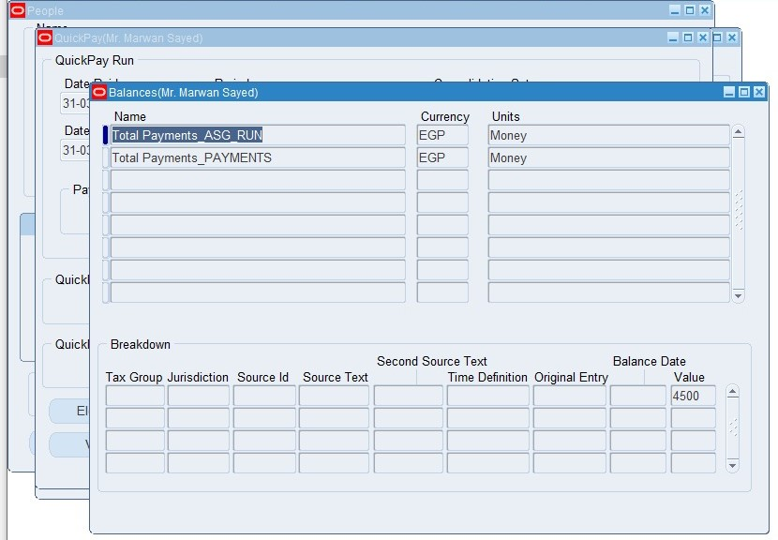
3-Payroll
To view the result we can see that it from the following path
Path>people>enter and maintain>assignment>others> Quick pay>view results>balances> standard balances window and we can see the value of amount is 4500 EGP
(Responsibility MS99_)

Slide 32
Any questions??

Slide 33
Special thanks to
1-Dr: Nader Elhabashy for his guides and his efforts for teaching us
2- to my teammates for their efforts to establish this project
1-Maiada El Ganzory
2- Abdullah Salah
3- Mai Hesham

Slide 34
Thank you

